Slide 1
Chapter 1: Introduction

Slide 2
What is an Operating System?
A program that acts as an intermediary between a user of a computer and the computer hardware
Operating system goals:
Execute user programs and make solving user problems easier
Make the computer system convenient to use
Use the computer hardware in an efficient manner

Slide 3
Computer System Structure
Computer system can be divided into four components:
Hardware – provides basic computing resources
CPU, memory, I/O devices
Operating system
Controls and coordinates use of hardware among various applications and users
Application programs – define the ways in which the system resources are used to solve the computing problems of the users
Word processors, compilers, web browsers, database systems, video games
Users
People, machines, other computers

Slide 4
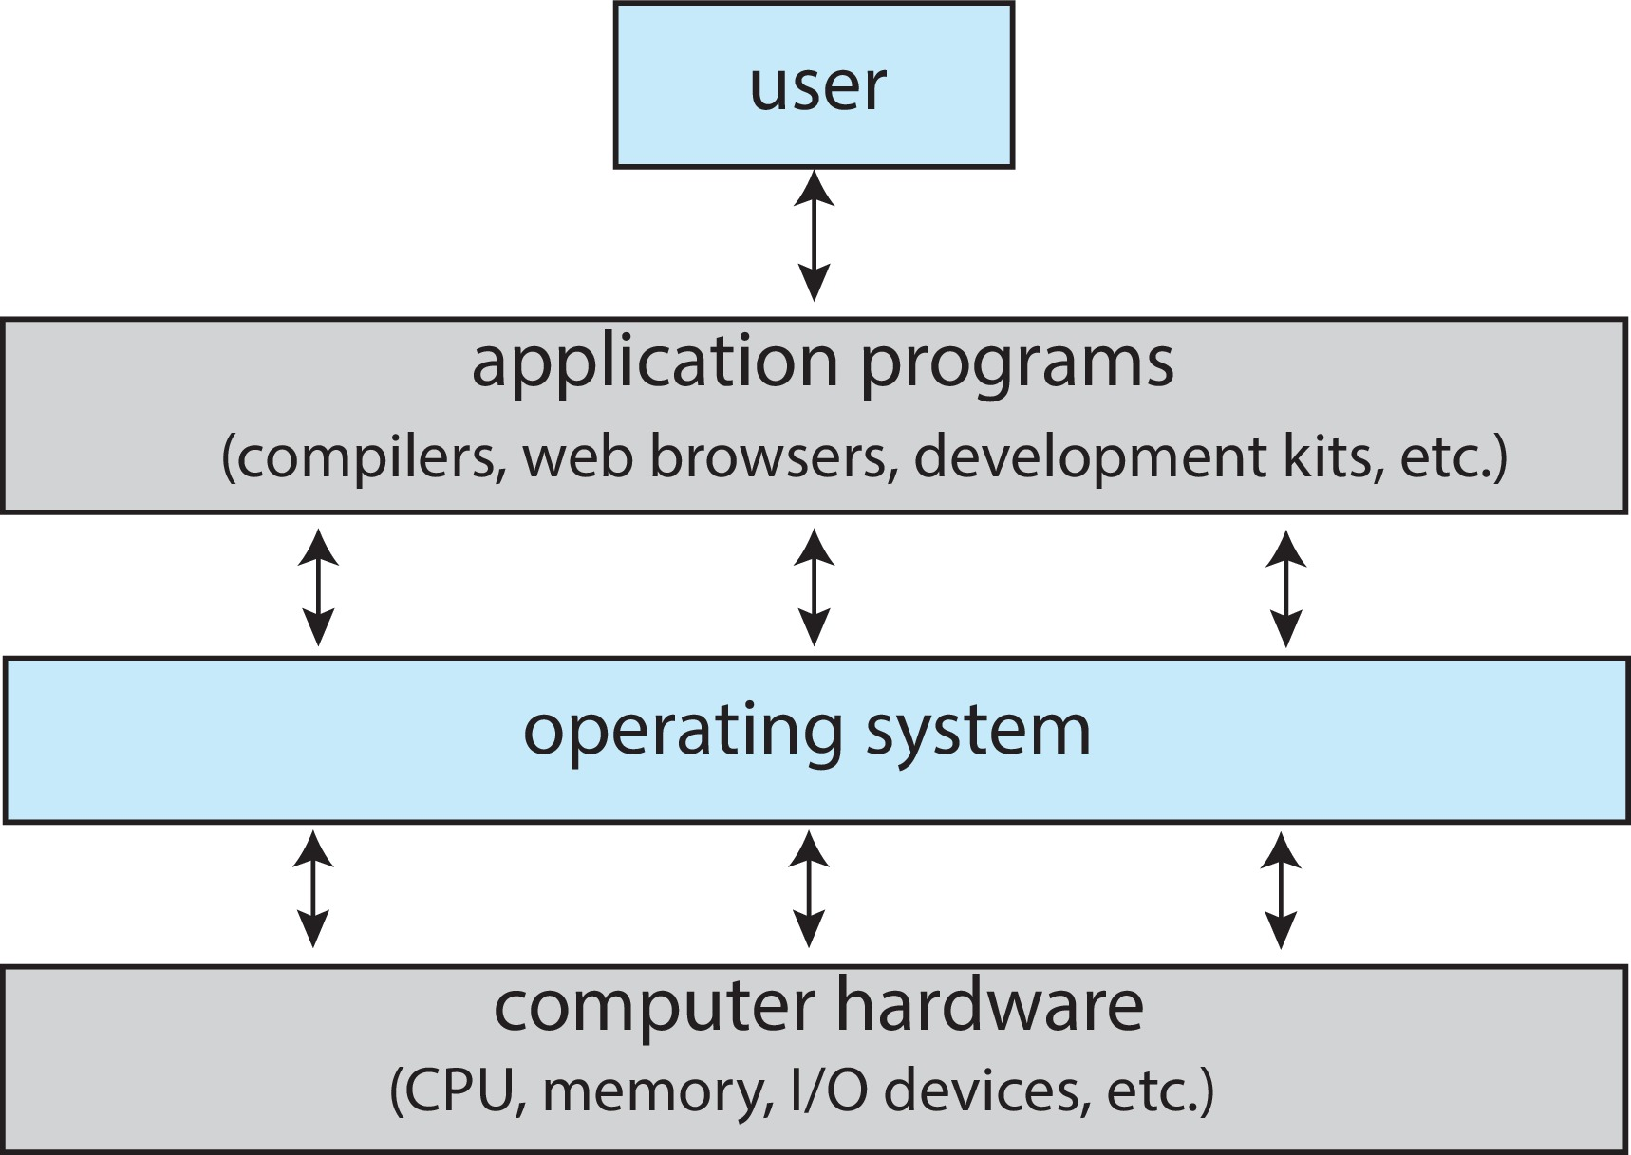
Abstract View of Components of Computer

Slide 5
What Operating Systems Do
Depends on the point of view
Users want convenience, ease of use and good performance
Don’t care about resource utilization
But shared computer such as mainframe or minicomputer must keep all users happy
Operating system is a resource allocator and control program making efficient use of HW and managing execution of user programs
Users of dedicate systems such as workstations have dedicated resources but frequently use shared resources from servers
Mobile devices like smartphones and tables are resource poor, optimized for usability and battery life
Mobile user interfaces such as touch screens, voice recognition
Some computers have little or no user interface, such as embedded computers in devices and automobiles
Run primarily without user intervention

Slide 6
Operating-System Operations
Bootstrap program – simple code to initialize the system, load the kernel
Kernel loads
Starts system daemons (services provided outside of the kernel)
Kernel interrupt driven (hardware and software)
Hardware interrupt by one of the devices
Software interrupt (exception or trap):
Software error (e.g., division by zero)
Request for operating system service – system call
Other process problems include infinite loop, processes modifying each other or the operating system

Slide 7
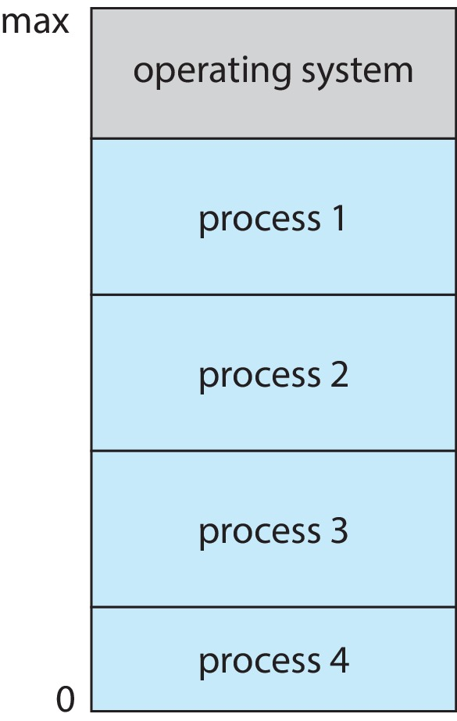
Memory Layout for Multiprogrammed System

Slide 8
Dual-mode Operation
Dual-mode operation allows OS to protect itself and other system components
User mode and kernel mode
Mode bit provided by hardware
Provides ability to distinguish when system is running user code or kernel code.
When a user is running  mode bit is “user”
When kernel code is executing  mode bit is “kernel”
How do we guarantee that user does not explicitly set the mode bit to “kernel”?
System call changes mode to kernel, return from call resets it to user
Some instructions designated as privileged, only executable in kernel mode

Slide 9
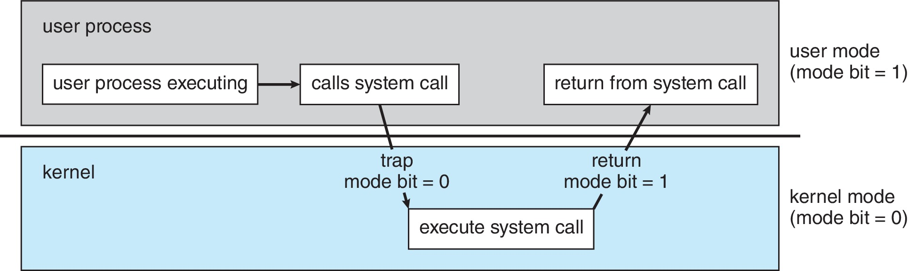
Transition from User to Kernel Mode

Slide 10
Timer
Timer to prevent infinite loop (or process hogging resources)
Timer is set to interrupt the computer after some time period
Keep a counter that is decremented by the physical clock
Operating system set the counter (privileged instruction)
When counter zero generate an interrupt
Set up before scheduling process to regain control or terminate program that exceeds allotted time

Slide 11
Process Management
A process is a program in execution. It is a unit of work within the system. Program is a passive entity; process is an active entity.
Process needs resources to accomplish its task
CPU, memory, I/O, files
Initialization data
Process termination requires reclaim of any reusable resources
Single-threaded process has one program counter specifying location of next instruction to execute
Process executes instructions sequentially, one at a time, until completion
Multi-threaded process has one program counter per thread
Typically system has many processes, some user, some operating system running concurrently on one or more CPUs
Concurrency by multiplexing the CPUs among the processes / threads

Slide 12
Process Management Activities
The operating system is responsible for the following activities in connection with process management:
Creating and deleting both user and system processes
Suspending and resuming processes
Providing mechanisms for process synchronization
Providing mechanisms for process communication
Providing mechanisms for deadlock handling

Slide 13
Memory Management
To execute a program all (or part) of the instructions must be in memory
All (or part) of the data that is needed by the program must be in memory
Memory management determines what is in memory and when
Optimizing CPU utilization and computer response to users
Memory management activities
Keeping track of which parts of memory are currently being used and by whom
Deciding which processes (or parts thereof) and data to move into and out of memory
Allocating and deallocating memory space as needed

Slide 14
File-system Management
OS provides uniform, logical view of information storage
Abstracts physical properties to logical storage unit - file
Each medium is controlled by device (i.e., disk drive, tape drive)
Varying properties include access speed, capacity, data-transfer rate, access method (sequential or random)
File-System management
Files usually organized into directories
Access control on most systems to determine who can access what
OS activities include
Creating and deleting files and directories
Primitives to manipulate files and directories
Mapping files onto secondary storage
Backup files onto stable (non-volatile) storage media

Slide 15
Mass-Storage Management
Usually disks used to store data that does not fit in main memory or data that must be kept for a “long” period of time
Proper management is of central importance
Entire speed of computer operation hinges on disk subsystem and its algorithms
OS activities
Mounting and unmounting
Free-space management
Storage allocation
Disk scheduling
Partitioning
Protection

Slide 16
Caching
Important principle, performed at many levels in a computer (in hardware, operating system, software)
Information in use copied from slower to faster storage temporarily
Faster storage (cache) checked first to determine if information is there
If it is, information used directly from the cache (fast)
If not, data copied to cache and used there
Cache smaller than storage being cached
Cache management important design problem
Cache size and replacement policy

Slide 17
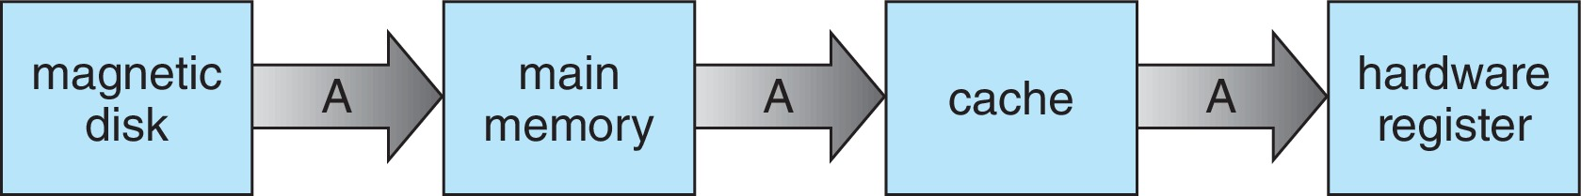
Migration of data “A” from Disk to Register
Multitasking environments must be careful to use most recent value, no matter where it is stored in the storage hierarchy
Multiprocessor environment must provide cache coherency in hardware such that all CPUs have the most recent value in their cache
Distributed environment situation even more complex
Several copies of a datum can exist
Various solutions covered in Chapter 19

Slide 18
Protection and Security
Protection – any mechanism for controlling access of processes or users to resources defined by the OS
Security – defense of the system against internal and external attacks
Huge range, including denial-of-service, worms, viruses, identity theft, theft of service
Systems generally first distinguish among users, to determine who can do what
User identities (user IDs, security IDs) include name and associated number, one per user
User ID then associated with all files, processes of that user to determine access control
Group identifier (group ID) allows set of users to be defined and controls managed, then also associated with each process, file

Slide 19
Distributed Systems
Collection of separate, possibly heterogeneous, systems networked together
Network is a communications path, TCP/IP most common
Local Area Network (LAN)
Wide Area Network (WAN)
Metropolitan Area Network (MAN)
Personal Area Network (PAN)
Network Operating System provides features between systems across network
Communication scheme allows systems to exchange messages
Illusion of a single system
Sharing resource increases computation speed, functionality, availability and reliability.

Slide 20
End of Chapter 1

